Slide 1
Statewise Promotions and sales
File created on: 7/12/19 6:42:31 PM EDT

Slide 2
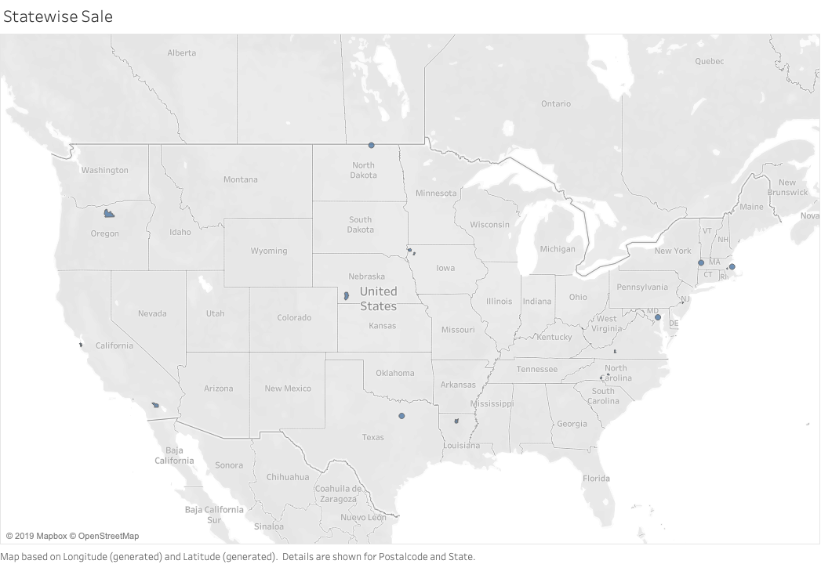

Slide 3
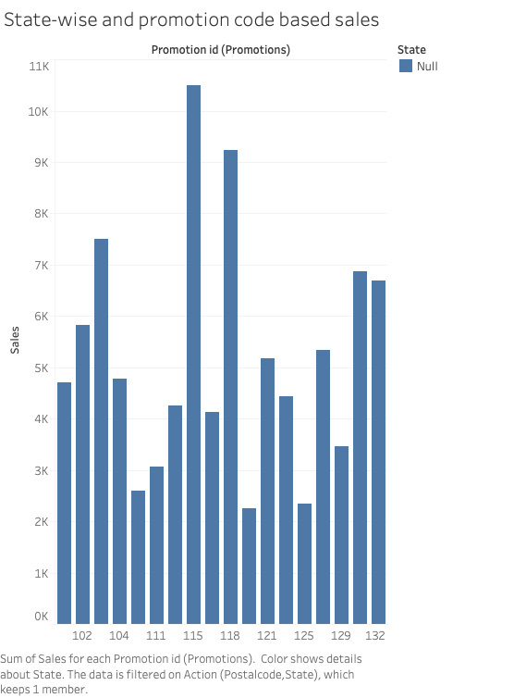

Slide 4
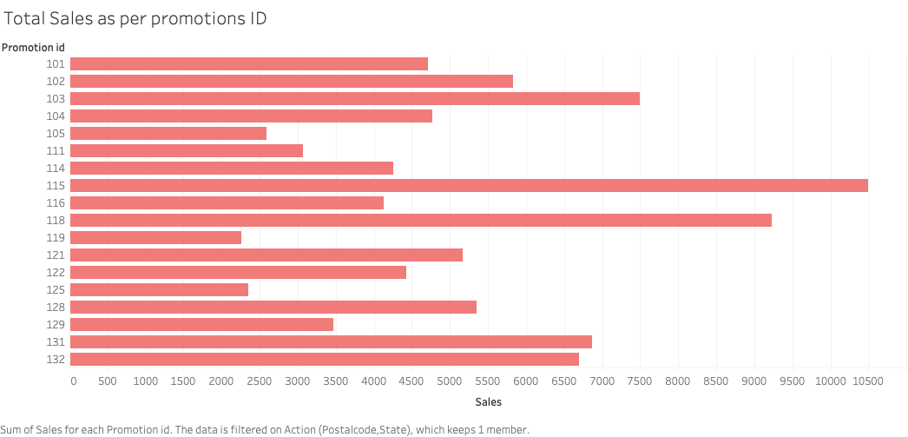

Slide 5
